Slide 1
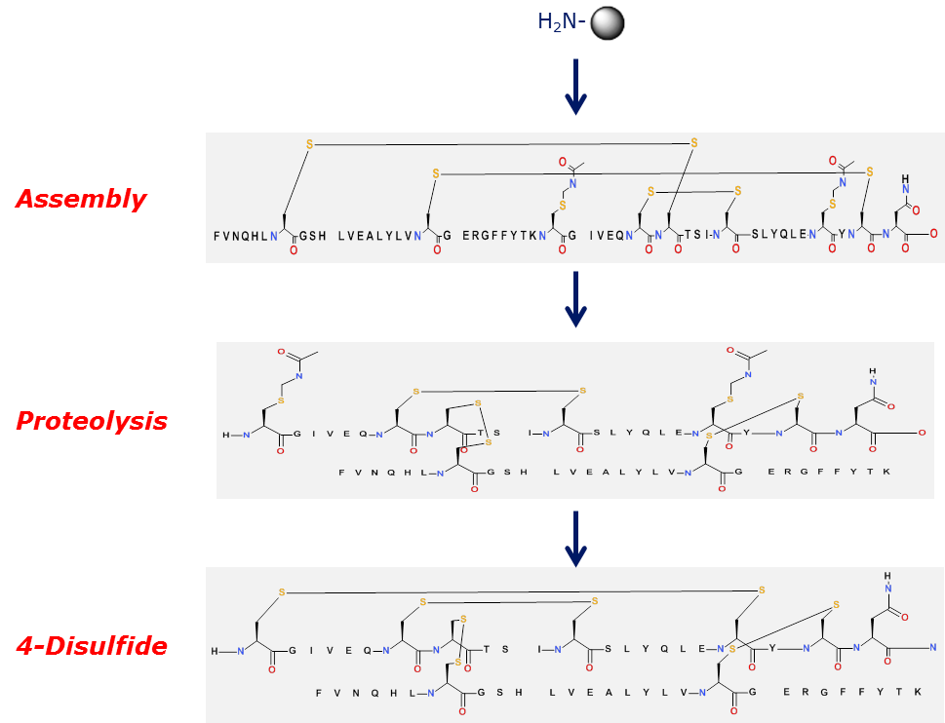
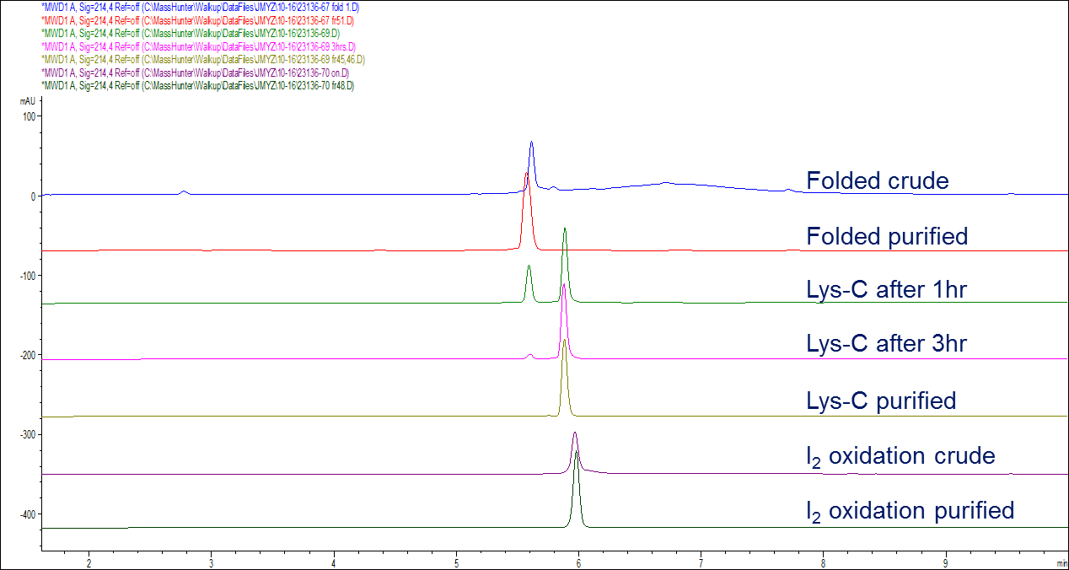
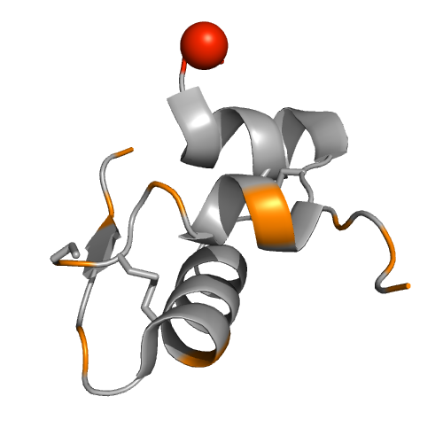
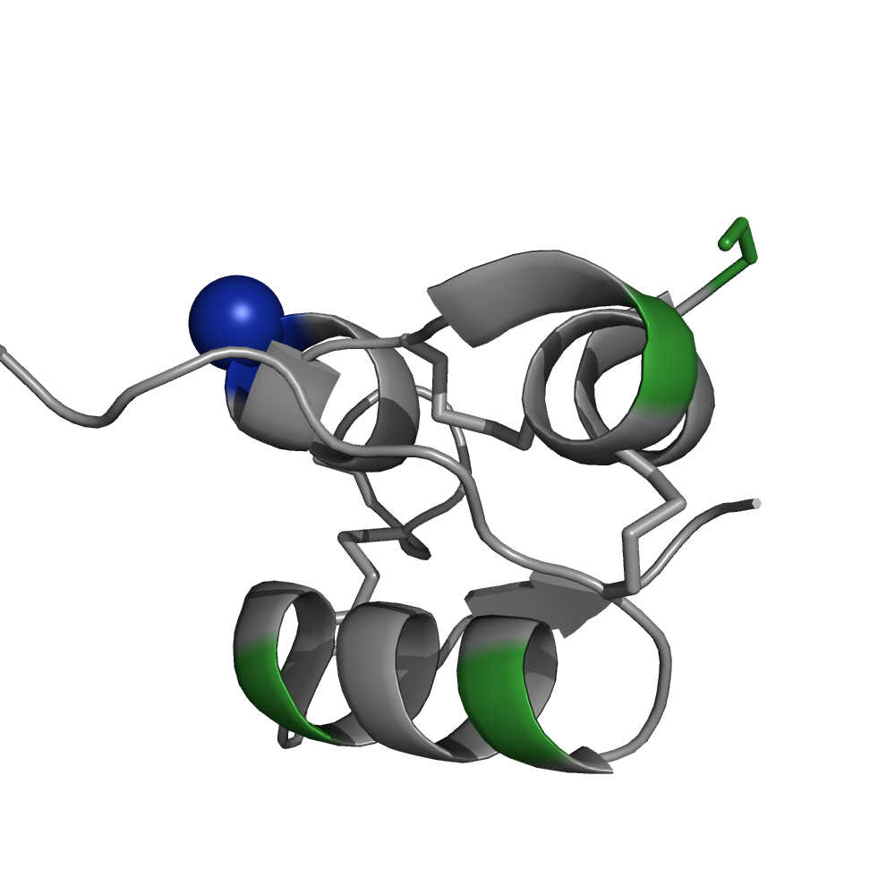
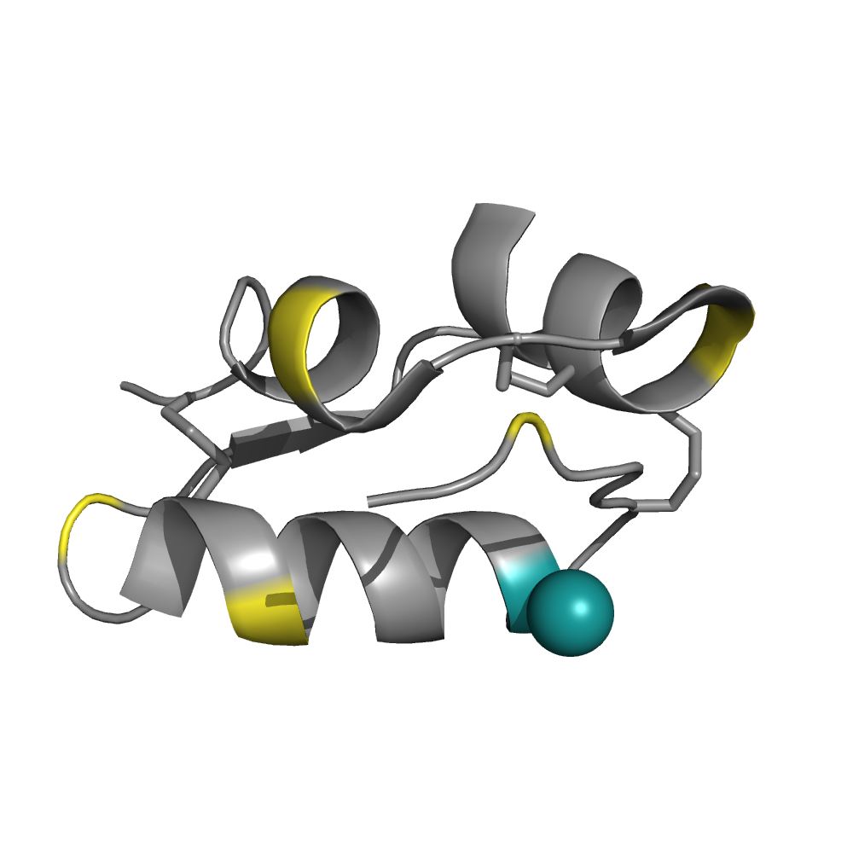
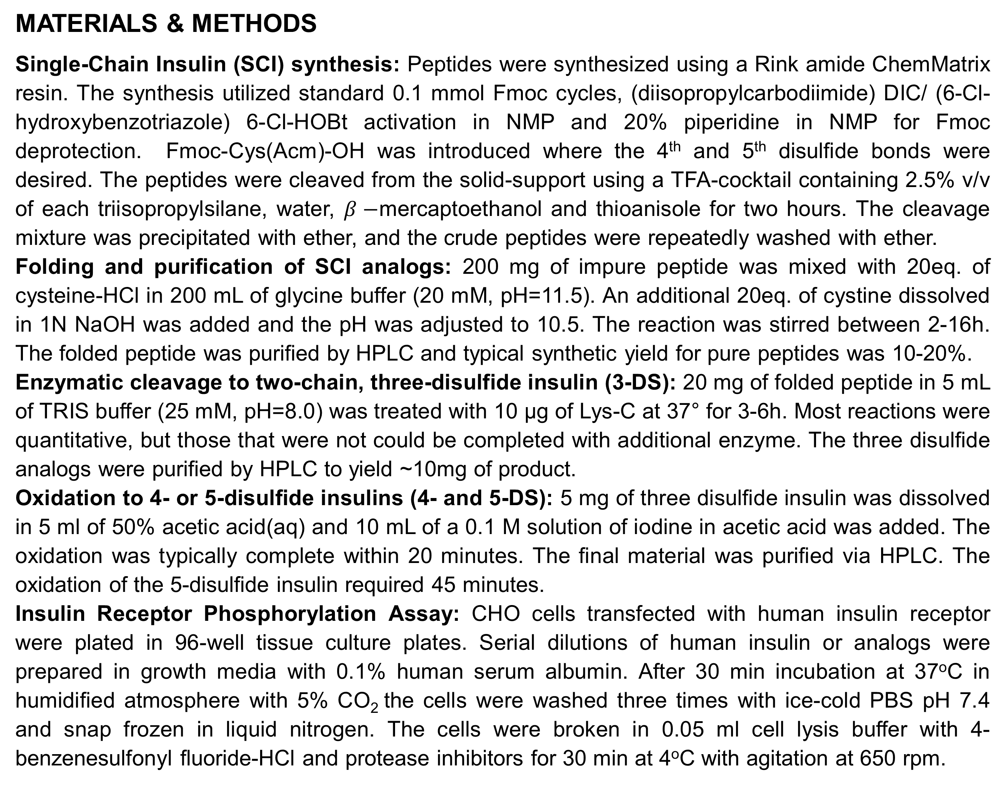
Insulin Macrocyclization to Explore the Relationship
Between Molecular Flexibility and Biological Activity
Florence Brunel¹, John Mayer², Vasily Gelfanov¹, Alexander Zaykov¹, Brian Finan¹, Diego Perez-Tilve³ and Richard DiMarchi^{1,2}
¹Novo Nordisk Research Center, Indianapolis Indiana
²Department of Chemistry, Indiana University, Bloomington Indiana
³Department of Internal Medicine, University of Cincinnati College of Medicine, Cincinnati Ohio
INTRODUCTION
The chemical synthesis of insulin has historically been a challenging endeavor given the hydrophobic nature of the A-chain and its two-chain, three-disulfide structure. The last decade has witnessed sizable progress driven by two independent synthetic strategies based either on oxidative folding of linear single-chain intermediates, or directed disulfide bond formation through orthogonal cysteine protection¹. These advances have enabled the synthesis of insulin analogs with additional disulfide bridges that until recently had not been accessible. These extra non-native bonds constrain the molecular flexibility of the hormone, and as such we have assessed the effect on biological action. Insulin is well-recognized as a peptide hormone that requires conformational freedom, specifically in the terminal end of the B-chain, to achieve high potency signaling at its receptor^{2,3}. With this as an objective, we have successfully synthesized 20 insulin analogs that contain a site-specific fourth disulfide bridge (4-DS) by orthogonally forming the non-native bond in a manner that provides opportunity to study the hormone in macrocyclic-constrained and unconstrained forms. A single analog containing two extra bonds, resulting in a total of five disulfides (5-DS), was also successfully synthesized. The biological activity within this novel series of insulin analogs proved highly dependent on the location of the additional disulfide bond, and there was a linear correlation between in vitro and in vivo potency. These peptides constitute an important addition to the collective library of insulin analogs that includes a prior set of 4-DS analogs made by biosynthesis⁴.
RESULTS
Twenty 4-disulfide (4-DS) containing insulins were chemically synthesized (Fig. 1, 2 and Table 1). There was no targeted analog that could not be prepared by the straightforward single chain DesDi synthetic protocol.
A single analog with five disulfide bonds (compound 21) was also prepared and represents the most structurally constrained insulin analog studied to date, with twenty percent of the amino acid sequence being cysteine (Fig. 3).
The magnitude in loss of activity upon macrocyclization is highly dependent on the position of the fourth disulfide bond. Cross-links in the N-terminal region of A chain with various other locations in A and B-chains result in large loss of potency, but the magnitude was site-specific. For example, an additional disulfide between A0 and B17, B22 or B26 led to more than a 100x reduction in activity, where a fourth bond between A0 and B0 was ~2x less active. The positions substituted for cysteine to form the non-native fourth disulfide bond are shown in Fig. 4.
We have identified 6 pairs (and the 5 DS compound) that resulted in over a 100-fold or greater in vitro loss of potency upon macrocyclization (Table 1, red). These constrained insulins were confirmed to be inactive in vivo at 100 nmol/kg, while being active in the unconstrained form at one-tenth the dose (Fig 5 and 6).
MATERIALS & METHODS
Single-Chain Insulin (SCI) synthesis: Peptides were synthesized using a Rink amide ChemMatrix resin. The synthesis utilized standard 0.1 mmol Fmoc cycles, (diisopropylcarbodiimide) DIC/ (6-Cl-hydroxybenzotriazole) 6-Cl-HOBt activation in NMP and 20% piperidine in NMP for Fmoc deprotection. Fmoc-Cys(Acm)-OH was introduced where the 4th and 5th disulfide bonds were desired. The peptides were cleaved from the solid-support using a TFA-cocktail containing 2.5% v/v of each triisopropylsilane, water, $β−$mercaptoethanol and thioanisole for two hours. The cleavage mixture was precipitated with ether, and the crude peptides were repeatedly washed with ether.
Folding and purification of SCI analogs: 200 mg of impure peptide was mixed with 20eq. of cysteine-HCl in 200 mL of glycine buffer (20 mM, pH=11.5). An additional 20eq. of cystine dissolved in 1N NaOH was added and the pH was adjusted to 10.5. The reaction was stirred between 2-16h. The folded peptide was purified by HPLC and typical synthetic yield for pure peptides was 10-20%.
Enzymatic cleavage to two-chain, three-disulfide insulin (3-DS): 20 mg of folded peptide in 5 mL of TRIS buffer (25 mM, pH=8.0) was treated with 10 µg of Lys-C at 37° for 3-6h. Most reactions were quantitative, but those that were not could be completed with additional enzyme. The three disulfide analogs were purified by HPLC to yield ~10mg of product.
Oxidation to 4- or 5-disulfide insulins (4- and 5-DS): 5 mg of three disulfide insulin was dissolved in 5 ml of 50% acetic acid(aq) and 10 mL of a 0.1 M solution of iodine in acetic acid was added. The oxidation was typically complete within 20 minutes. The final material was purified via HPLC. The oxidation of the 5-disulfide insulin required 45 minutes.
Insulin Receptor Phosphorylation Assay: CHO cells transfected with human insulin receptor were plated in 96-well tissue culture plates. Serial dilutions of human insulin or analogs were prepared in growth media with 0.1% human serum albumin. After 30 min incubation at 37ºC in humidified atmosphere with 5% CO₂ the cells were washed three times with ice-cold PBS pH 7.4 and snap frozen in liquid nitrogen. The cells were broken in 0.05 ml cell lysis buffer with 4-benzenesulfonyl fluoride-HCl and protease inhibitors for 30 min at 4ºC with agitation at 650 rpm.
Table 1. Activity of open & closed insulin measured by receptor phosphorylation.
Highlighted peptides result in around or more than a hundred-fold loss of activity upon cyclization.
A 0
A14
B10
Fig. 4: Location of the extra disulfides: A0 and its ten X-linked positions (orange), A14 and its three X-linked positions (green), B10 and its five X-linked positions (yellow).
Fig. 1: Schematic representation of
4DS, A0-A18 insulin synthesis.
Fig. 2: HPLC analysis of 4DS, A0-A18
insulin synthesis.
Fig. 3: Synthesis of a single analog containing five disulfides by a 3+2 approach.
Fig. 5: Open insulins at 10 nmol/kg, are active while the closed analogs are not.
Fig. 6: Closed insulins are inactive at 100 nmol/kg.
REFERENCES
Liu, F., Li, P., Gelfanov, V., Mayer J., DiMarchi, R. Synthetic advances in insulin-like peptides enable novel bioactivity. Acc. Chem. Res. 50, 1855-1865 (2017).
De Meyts, P., Whittaker, J. Structural biology of insulin and IGF1 receptors: implication for drug design. Nat. Rev. Drug Discov. 1, 769-783 (2002).
Menting, J.G. et al Protective hinge in insulin opens to enable its receptor engagement. PNAS. 111, 3395-3404 (2014).
Vinther, T. et al Insulin analog with additional disulfide bond has increased stability and preserved activity. Protein Sci. 22, 296-305 (2013).
CONCLUSIONS
Employing recent advances in synthetic chemistry, we have introduced with high proficiency an extra disulfide bond to insulin at twenty different locations. Each analog was made in sufficient yield to support biological study. The synthetic strategy used to prepare these novel macrocycles supported analysis in the unconstrained (3-DS) and constrained forms (4-DS & 5-DS). With the exception of two A0-analogs, the peptides were of high relative potency in the open form (3-DS). The localization of the extra bond sizably impacts the relative reduction in bioactivity after cross-linking. Six analogs displayed in vitro activity reduced by ~100-fold or greater when constrained, and were devoid of in vivo activity at a high dose of 100 nmol/kg in STZ treated diabetic mice. Collectively, the novel chemical approach has enabled unparalleled access to molecular diversity that enables further exploration in the relationship of structural mobility to biological activity.

